Slide 1
JCS1701-BIG DATA ANALYTICS
JERUSALEM COLLEGE OF ENGINEERING
DEPARTMENT OF COMPUTERSCIENCE ENGINEERING
Presented by:
M.MARIA JERALDIN SINDHIA , AP/CSE

Slide 2
Overview
Introduction
Why Big Data
Big Data(globally)
Big Data: 3 V’s
Big Data challenges
Big Data in Design Engineering
Reasons for the importance of Big Data
Cloud and Big Data
Big Data in Ecommerce
PLM in Big Data
Advantages
Conclusion

Slide 3
INTRODUCTION
Big data is the term for a collection of data sets so large and complex that it becomes difficult to process using on-hand database management tools or traditional data processing applications.
The challenges that we face with dbms tools and other technologies is capture, curation, storage, search, sharing, transfer, analysis, and visualization.

Slide 4
Why Big data
Key enablers for the appearance and growth of ‘Big-Data’ are:
Increase in storage capabilities
Increase in processing power
Availability of data

Slide 5
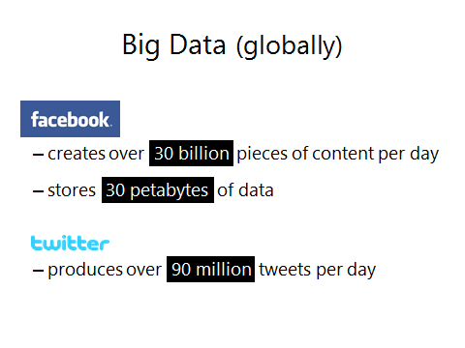

Slide 6
Big data: 3 V’s
Big data is usually transformed in three dimensions- volume, velocity and variety.
Volume: Machine generated data is produced in larger quantities than non traditional data.
Velocity: This refers to the speed of data processing.
Variety: This refers to large variety of input data which in turn generates large amount of data as output.

Slide 7
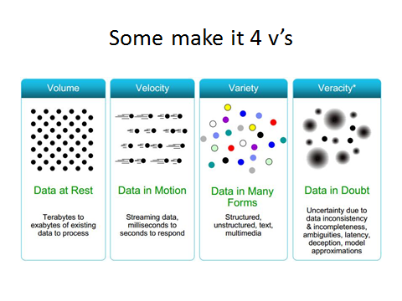
REF:2

Slide 8
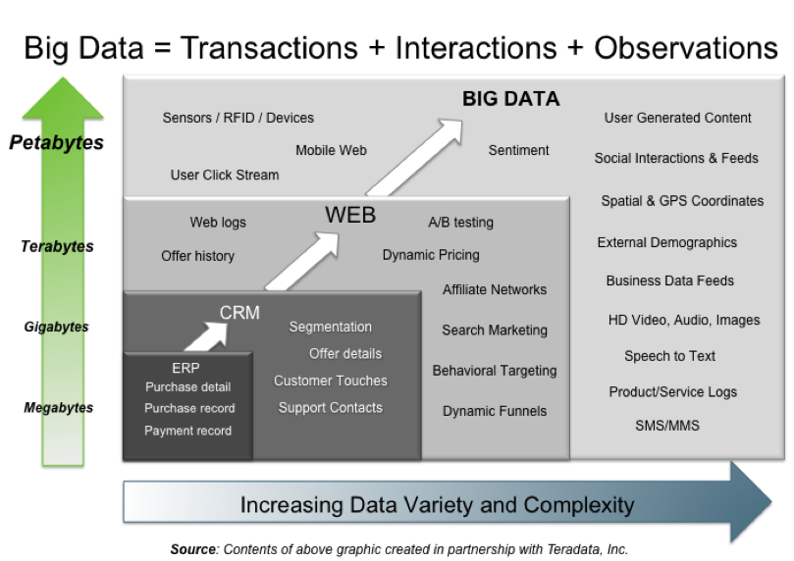
https://www.google.de/search?q=evolution+of+business+intelligence&newwindow=1&tbm=isch&tbo=u&source=univ&sa=X&ei=gEGoU5KXBuTb4QSGsoH4BQ&ved=0CDsQsAQ&biw=1366&bih=64

Slide 9
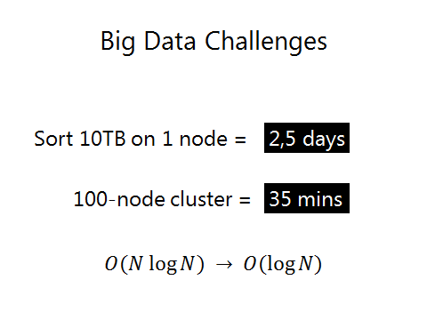

Slide 10



http://www.meltinfo.com/ppt/ibm-big-data

Slide 11
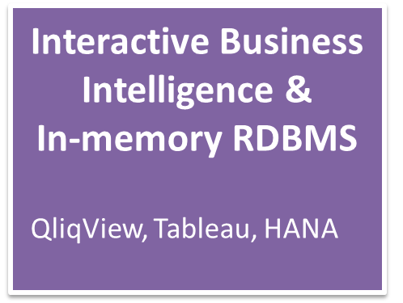
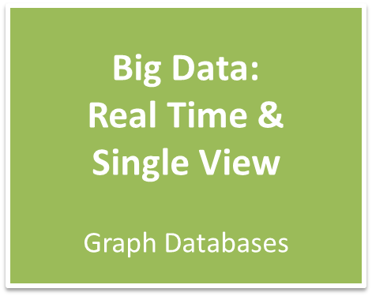



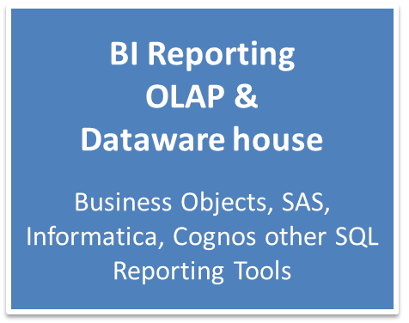
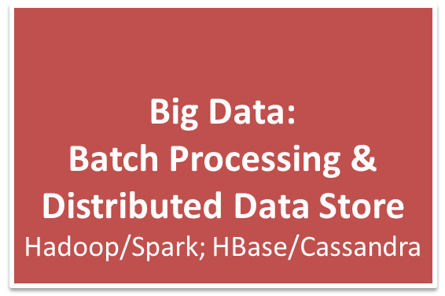


The Evolution of Business Intelligence
scale
scale
1990’s
2000’s
2010’s
https://www.google.de/search?q=evolution+of+business+intelligence&newwindow=1&tbm=isch&tbo=u&source=univ&sa=X&ei=gEGoU5KXBuTb4QSGsoH4BQ&ved=0CDsQsAQ&biw=1366&bih=64

Slide 12
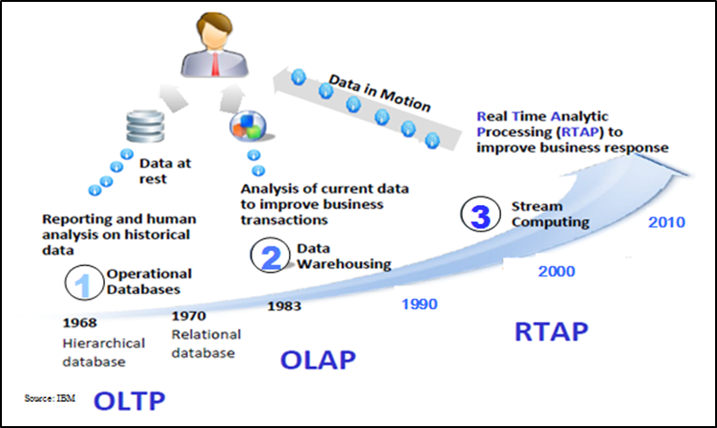
OLTP: Online Transaction Processing (DBMSs)
OLAP: Online Analytical Processing (Data Warehousing)
RTAP: Real-Time Analytics Processing (Big Data Architecture & technology)

Slide 13
Big data in design and engineering
Engineering department of manufacturing companies.
Boeing’s new 787 aircraft is perhaps the best example of Big Data, a plane designed and manufactured.
Big Data needs to be transferred for conversion into machining related information to allow the product to be manufactured.

Slide 14
Reasons for the importance of Big Data
Increase innovation and development of next generation product
Improve customer satisfaction
Sharpen competitive advantages
Create more narrow segmentation of customers
Reduce downtime

Slide 15
Cloud and big data
In fact from a Cloud perspective I believe that the transfer and archiving of Big Data will become a key capability of a manufacturing focused cloud environment.
Servers based on the Intel® Xeon® processor E5 and E7 families are at the heart of infrastructure that supports both cloud and big data environments.
Ideal for storing and processing large volumes of data
Web based tools will allow you to upload your Big Data to the manufacturing cloud,

Slide 16
Bigdata in Ecommerce
Collect, store and organize data from multiple data sources.
Bigdata track and better understand a variety of information from many different sources(i.e., inventory management system, CRM, Adword/Adsence analytics, email service provider statastics etc).

Slide 17
PLM in Big Data
Big data grows ridiculously fast
Most Big data is ephemeral by nature
Out-of-date Big data can undermine the results of your business analytics

Slide 18
PLM adopts Big Data?
Too big and too abstract.
This is not simple and will not happen overnight for most of manufacturing companies using PLM systems.
PLM data size may reach to yotta bytes

Slide 19
Advantages
Dialogue with consumers
Redevelop your products
Perform risk analysis
Keeping data safe
Customize your website in real time
Reducing maintenance cost

Slide 20
Conclusion
Silicon valley and through social media is making Big Data a global phenomenon
Not only Big Data is “cool” it happens to be a huge growth area as well.

Slide 21
Resources :
https://www.google.de/search?q=evolution+of+business+intelligence&newwindow=1&tbm=isch&tbo=u&source=univ&sa=X&ei=gEGoU5KXBuTb4QSGsoH4BQ&ved=0CDsQsAQ&biw=1366&bih=64
https://www.google.de/search?q=big+data+TRANSACTION+INTERACTION+OBSERVATION+EXAMPLE&newwindow=1&source=lnms&tbm=isch&sa=X&ei=DkaoU-H4K4Xe4QSO1oDwAg&ved=0CAgQ_AUoAQ&biw=1366&bih=643
http://www.tcs.com/SiteCollectionDocuments/White%20Papers/Knowledge-Big-Data-Analytics-Product-Development-1213-1.pdf
http://www.meltinfo.com/ppt/ibm-big-data
http://wwwiti.cs.uni-magdeburg.de/iti_db/forschung/index.php#projekte
http://datascienceseries.com/stories/ten-practical-big-data-benefits
http://www.intel.com/content/dam/www/public/us/en/documents/product-briefs/big-data-cloud-technologies-brief.pdf
http://www.bigdatalandscape.com/news/why-big-data-is-a-must-in-ecommerce
http://www.intel.com/content/dam/www/public/us/en/documents/product-briefs/big-data-cloud-technologies-brief.pdf
http://www.gxsblogs.com/morleym/2011/10/how-the-cloud-helps-manufacturers-address-%E2%80%98big-data%E2%80%99-challenges.html
http://www.itbusinessedge.com/blogs/integration/three-reasons-why-life-cycle-management-matters-more-with-big-data.html
http://www.forbes.com/sites/siliconangle/2012/02/29/big-data-is-creating-the-future-its-a-50-billion-market/
http://plmtwine.com/tag/big-data/
http://www.3dcadworld.com/big-data-will-important-manufacturers-future/

